Slide 1

Notes:
Introduction
Note – Parents, Teachers & Carers. You may wish to play the PowerPoint slide over two separate digital screens so you can read the notes while the pupil focuses on each slide, alternatively there is a separate word document containing the notes per side as well as the option to print.
Today we are going to learn about the water cycle, Scottish Water’s role within the water cycle and learn how we (you) can help protect it.

Slide 2
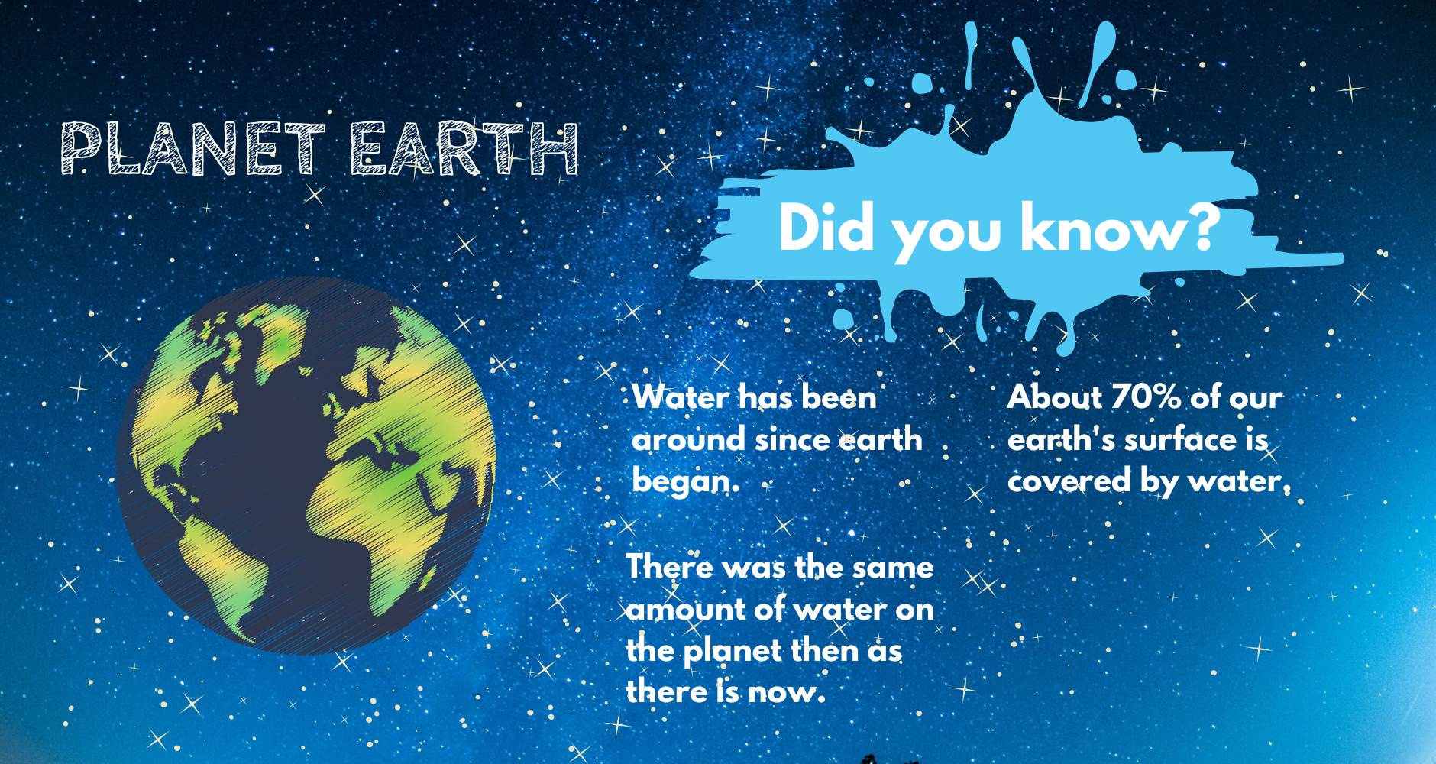


Notes:
Our planet
Click to hear sound – Apollo final mission take off
Planet earth is a beautiful place, especially here in Scotland. Did you know about 71% of earth’s surface is covered by water? (that’s a lot!) It is continuously recycled & occurs in three states; as solid (ice) liquid (water) and vapour (clouds)
Question: Do you know how old the earth is? You can give clues to help.
Answer: It is estimated that the world is over 4.2 billion years old.
Most of water on earth is salt water.
Question: Have you ever been to the sea and tasted the water by accident? It’s salty & untreated so we can’t drink it (yuk!) the rest of the water is called Fresh Water which is very important (est 3%)
Every living thing on this planet needs water to survive.
Question: Can you have a think about who needs water?
Answer: Cats, Dogs, Lions, Fish, People, Plants – all living things!
Lets watch a quick film!

Slide 3
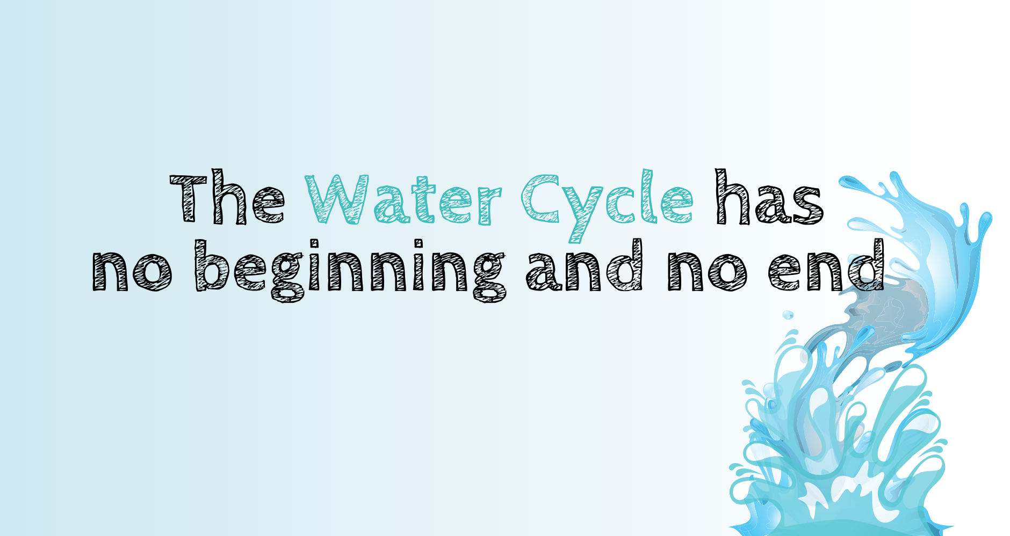
Notes:
The Water Cycle
The Water Cycle has no beginning and no end, meaning we have the same water now as we did millions of years ago. Which also means we drink the same water as brave knights, the Romans, the Victorians & our ancestors! (wow!)
Can you guess who else drank the same water as we do now? Example i.e. Vikings, Tudors, all living things throughout history!
Note (parent/teacher carer) If the pupil(s) guessed dinosaur go to next slide now – Excellent, well done!
If not - Would you believe us if we told you dinosaurs drank the same water as we do now? Turn to next slide

Slide 4
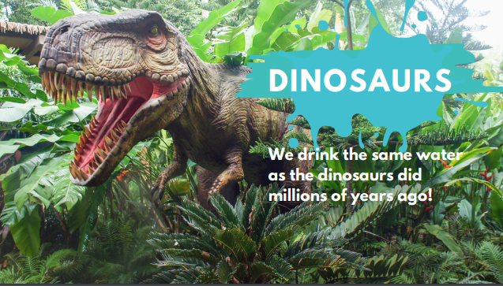
Click to hear sound
Notes:
Dinosaurs
Yes! unbelievable, we drink the same water as dinosaurs did millions of years ago!
Click to hear sound - That’s the sound of a T-Rex walking through the jungle.

Slide 5
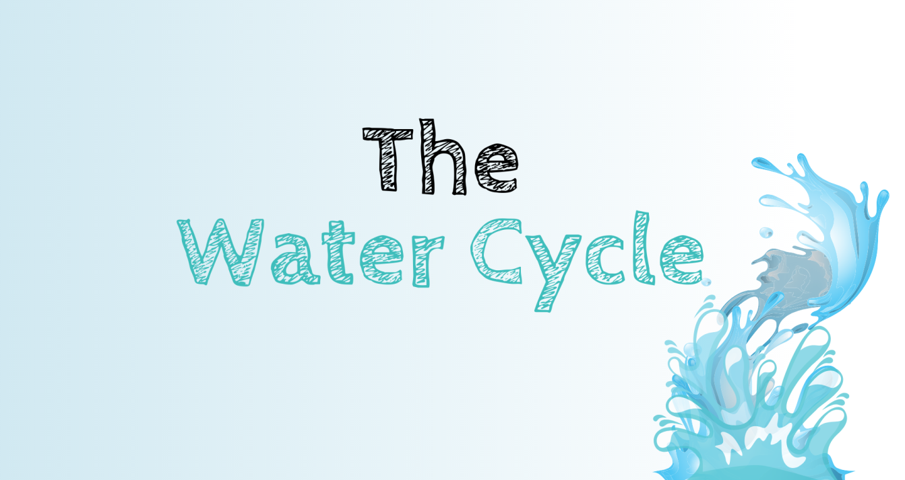
Notes:
How the Water Cycle works
Let’s learn about the water cycle and how it all works! Do you remember we talked about water occurring in three states? Liquid (water) solid (ice) and vapour (clouds) The water cycle involves all three!
Now we are going to breakdown the water cycle into 4 processes.

Slide 6
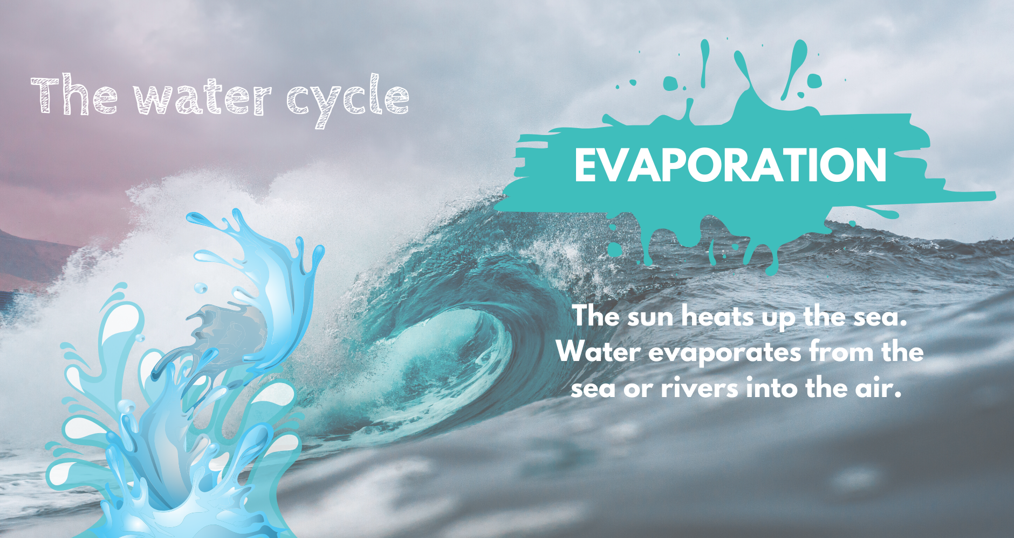
Notes:
Evaporation
Let’s break it down, first we have evaporation . The sun heats up the sea, water evaporates from the sea or rivers into the air.

Slide 7
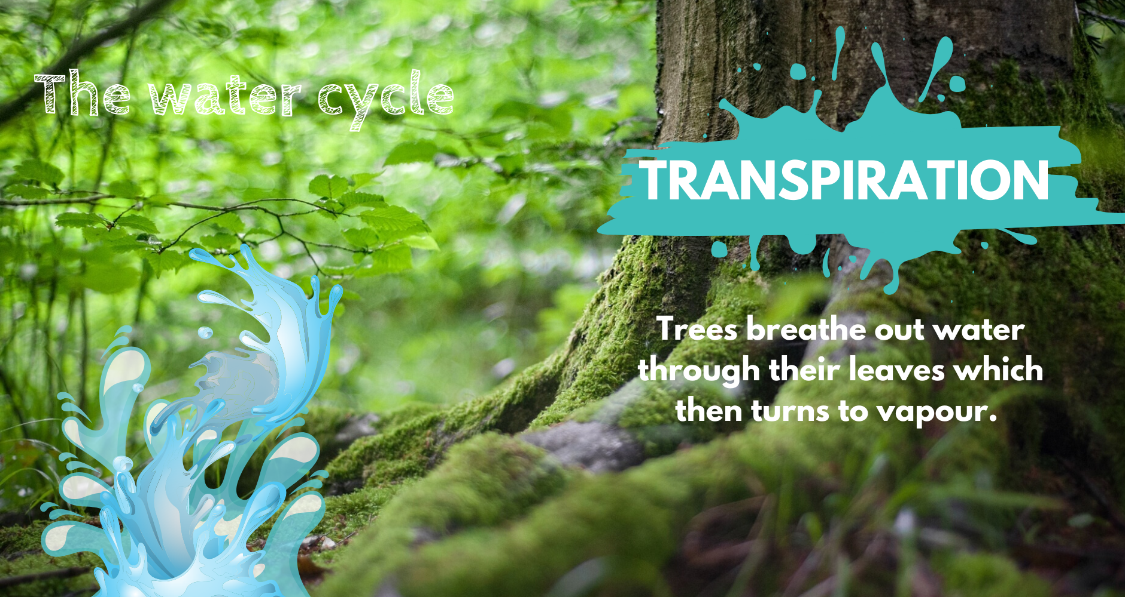
Notes:
Transpiration
Transpiration , trees breathe out water vapour through their leaves, then tiny water vapour rises up into the sky.

Slide 8
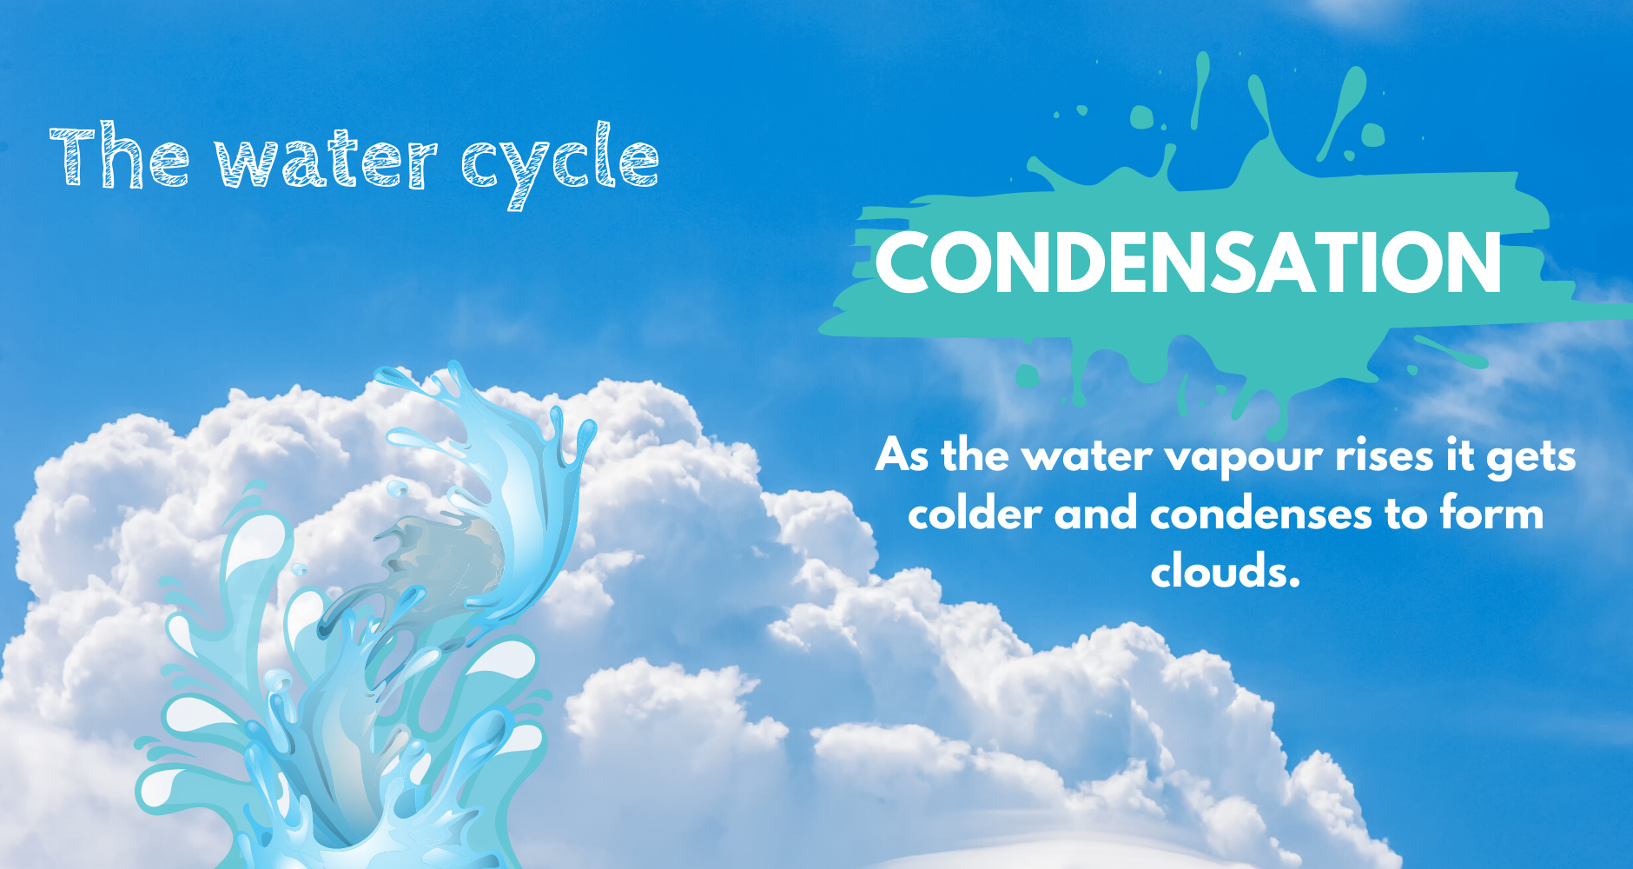
Notes:
Condensation
Next we have Condensation, as the water vapour rises it gets colder and condenses to form clouds.

Slide 9
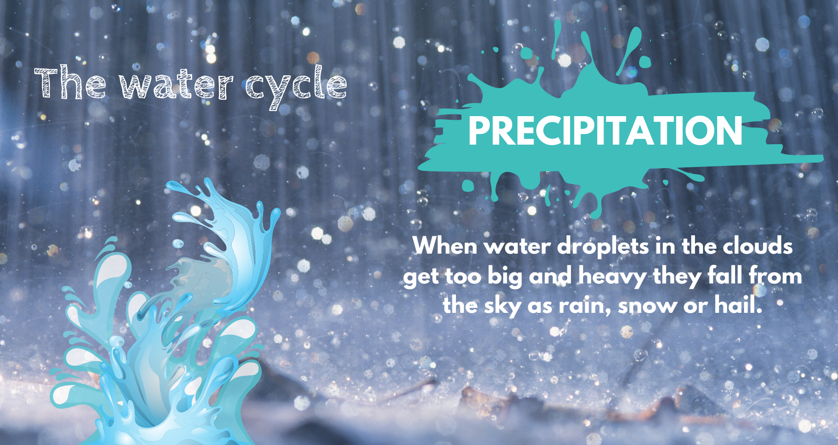
Notes:
Precipitation
And finally, Precipitation. When water droplets in the clouds get too big and heavy they fall from the sky as rain, snow or hail.
Some of this water feeds plants, trees and animals. The rest of the water flows into lochs, reservoirs and rivers. Rivers take the water back out to sea where the water cycle starts again.

Slide 10
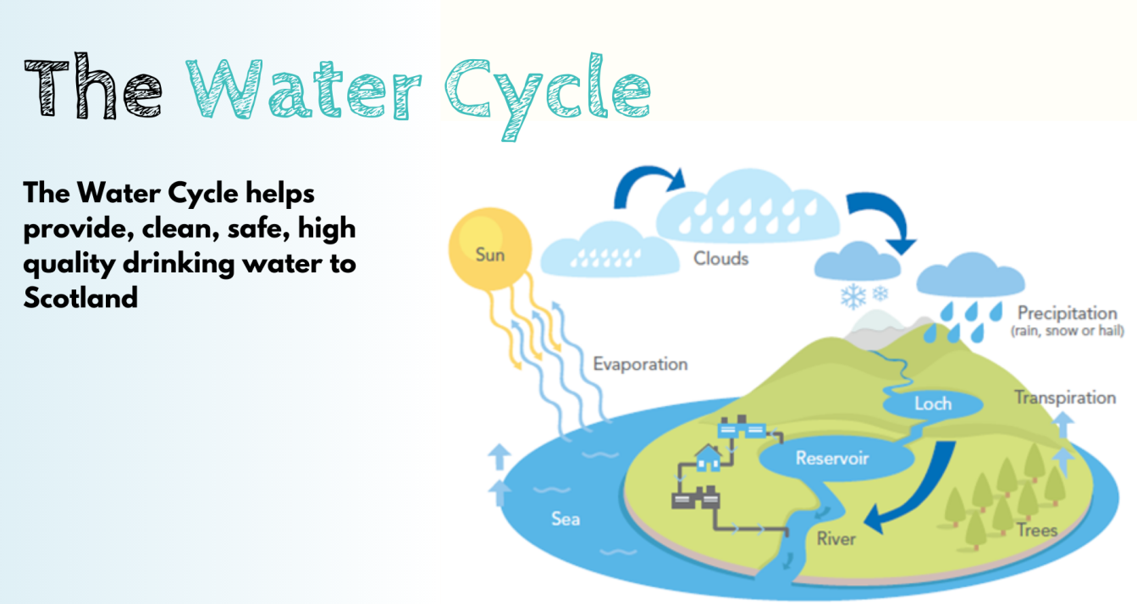
Click to hear sound
Notes:
The Water Cycle
Click for sound – Waves hitting shoreline of a pebble beach
Now you know the 4 elements of the water cycle, in this picture we see how it all comes together and is continuously recycled.
The water cycle is very important to Scottish Water as it helps them to provide safe, clean drinking water to households and businesses across Scotland 24 hours a day. They supply water to places like Schools, Hospitals, Libraries, and Hairdressers. Water goes round in a circle between the sea, the air and the ground.
Question: Can you think what else we use water for each day?
Answer: Cooking, cleaning, washing hands, washing the car, drinking, making tea and coffee, showers etc!
Question: Can you remember the four elements of the water cycle?
Answer: Condensation, Precipitation, Transpiration, Evaporation

Slide 11
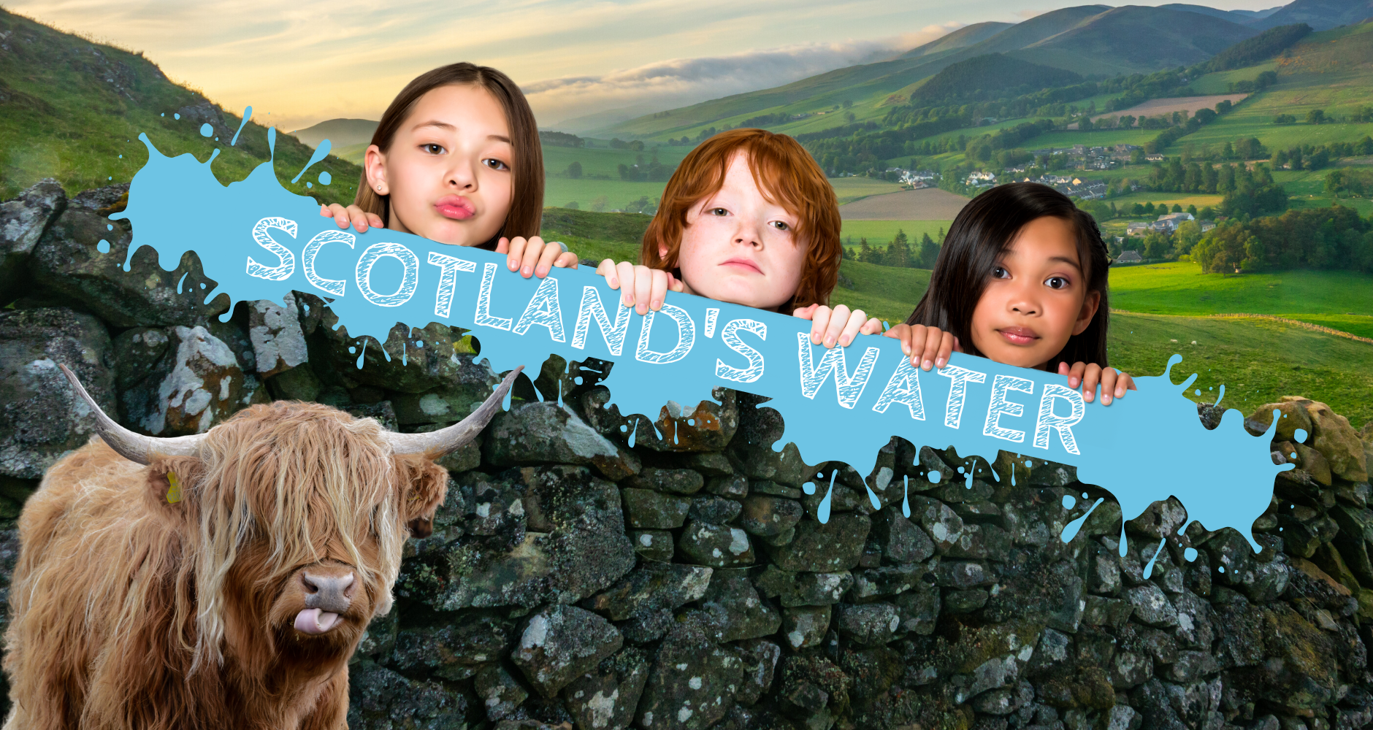

Notes:
Scotland’s Water
Click for sound – That’s a highland cow.
We have talked about our planet’s water and how the water cycle works & we know that every living thing on this planet needs water to survive. Now we are going to look at the water that belongs to Scotland & how Scottish Water play a role in getting that water to your home.

Slide 12
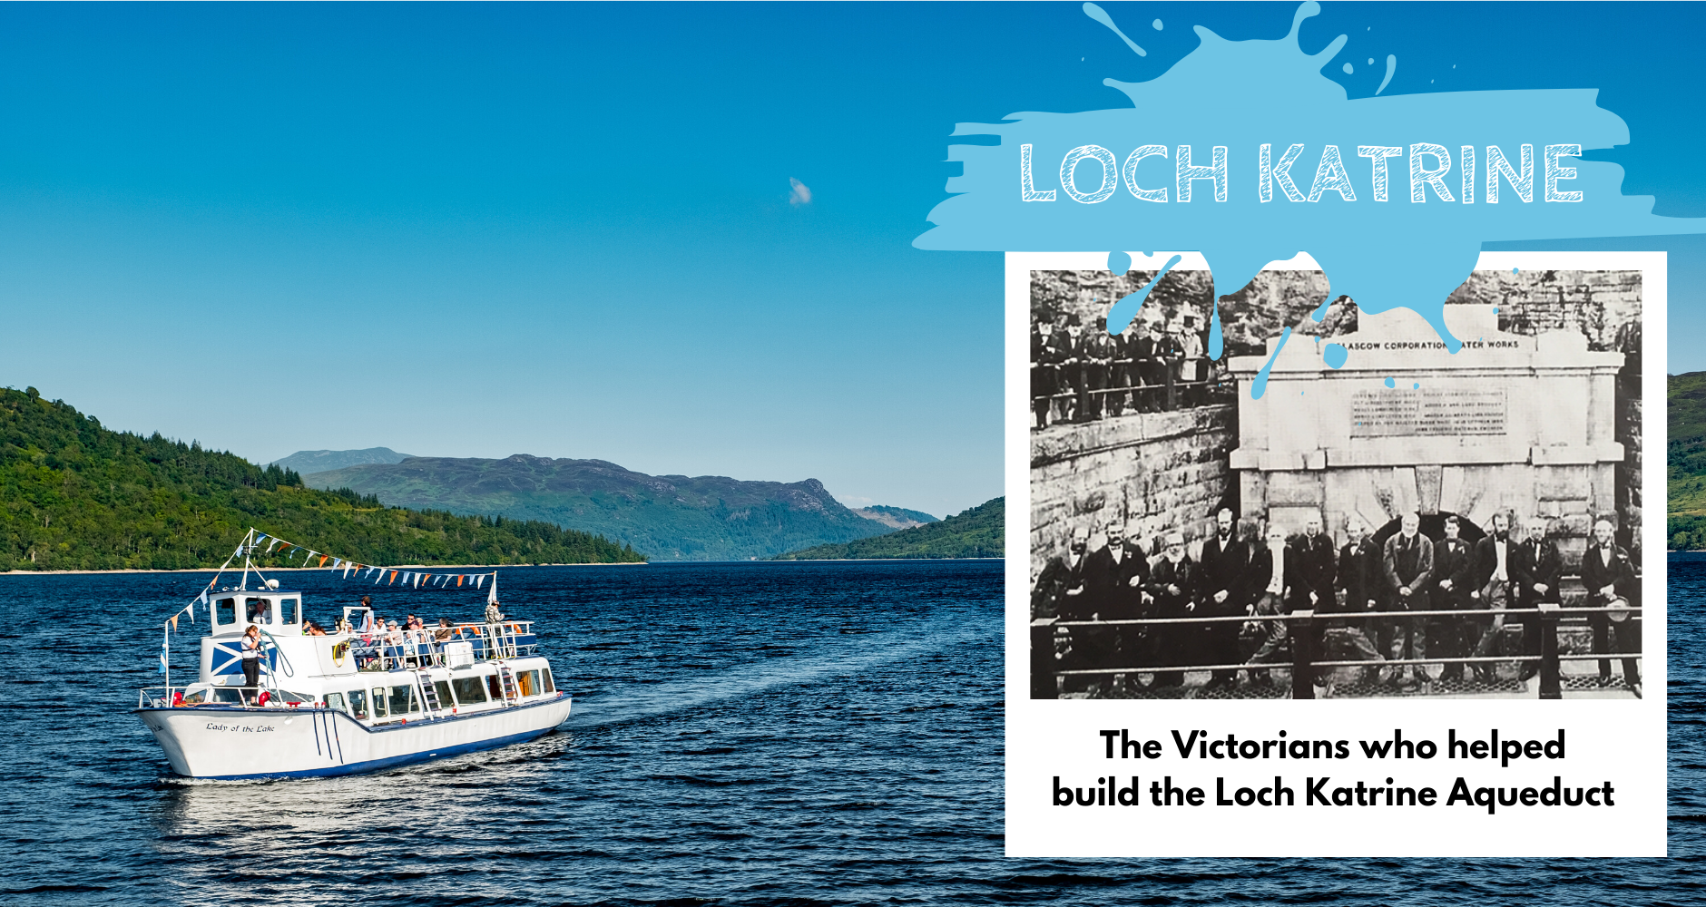
Notes:
Scotland’s Reservoirs
We are very lucky to live in a country where we get plenty of rain & have plenty sources of fresh water. Only 3% of all the water on earth is fresh water, most of which is frozen. Most of Scotland's fresh water which can be found in our rivers, lochs & streams.
Scottish Water has well over 200 reservoirs (there is a chance you may live next to one!) The one we can see in this picture is called Lock Katrine! A reservoir is a source of water which Scottish Water can use and send to our water treatment works where it is made safe for drinking. It then goes along our network of pipes to homes and businesses across Scotland. Fun Fact: We have enough pipes under the ground in Scotland to go around the planet twice!
The picture we can see in the slide is of the Victorians who mined through the hillsides and built the first pipes which brought water from Loch Katrine to the city of Glasgow! In 1859 Queen Victoria travelled to Loch Katrine to open the reservoir which transformed the health of Glasgow’s citizens.

Slide 13
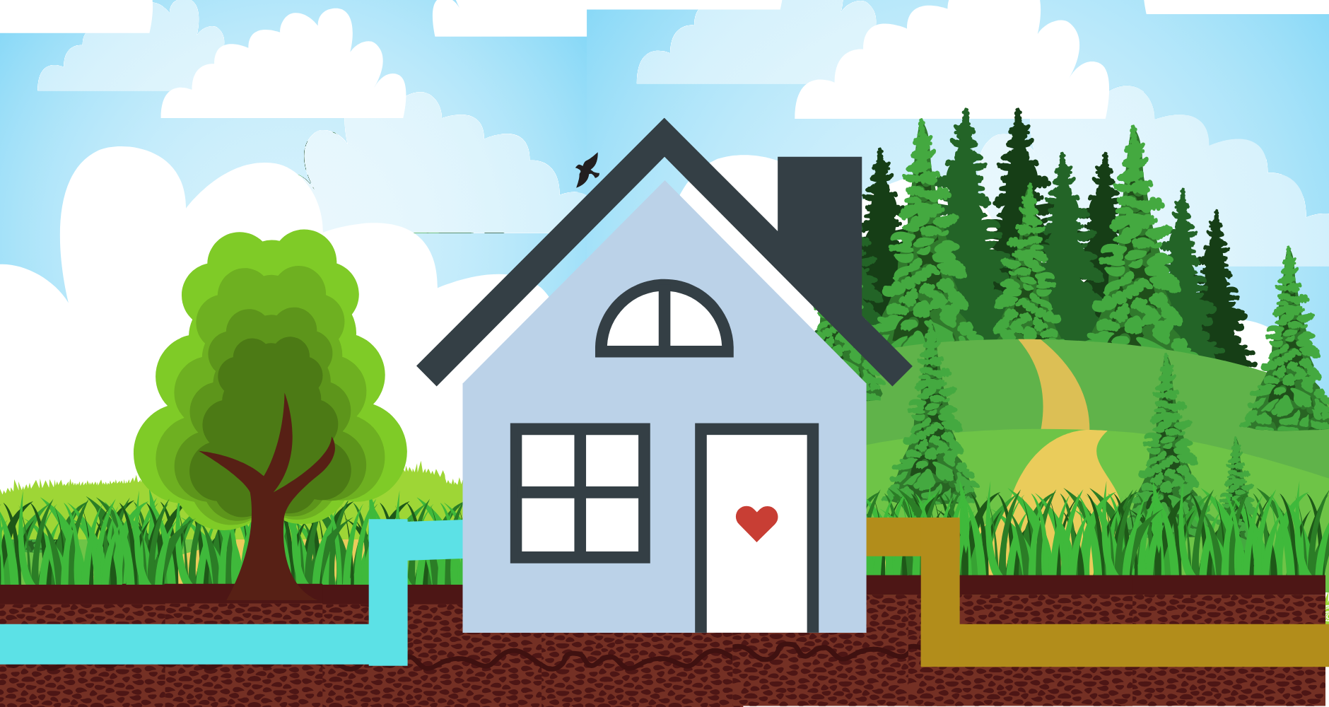
Notes:
Scottish Water
Scottish Water’s main responsibility is to supply safe clean water to your home, but we also take away, treat & clean the dirty water and put it back into the water cycle where it can be used again. See the clean water going in on the left & the dirty water being taken away on the right? (This isn’t exactly how our pipes look but we wanted to give you an example of how it works)
Have you heard about climate change & the importance of protecting our planet?
Next we are going to talk about how you can help Scottish Water to continue to provide water 24/hrs a day to your home as well as protect our planet & Scotland’s beautiful natural environment.

Slide 14

Notes:
So, how can you help us?

Slide 15
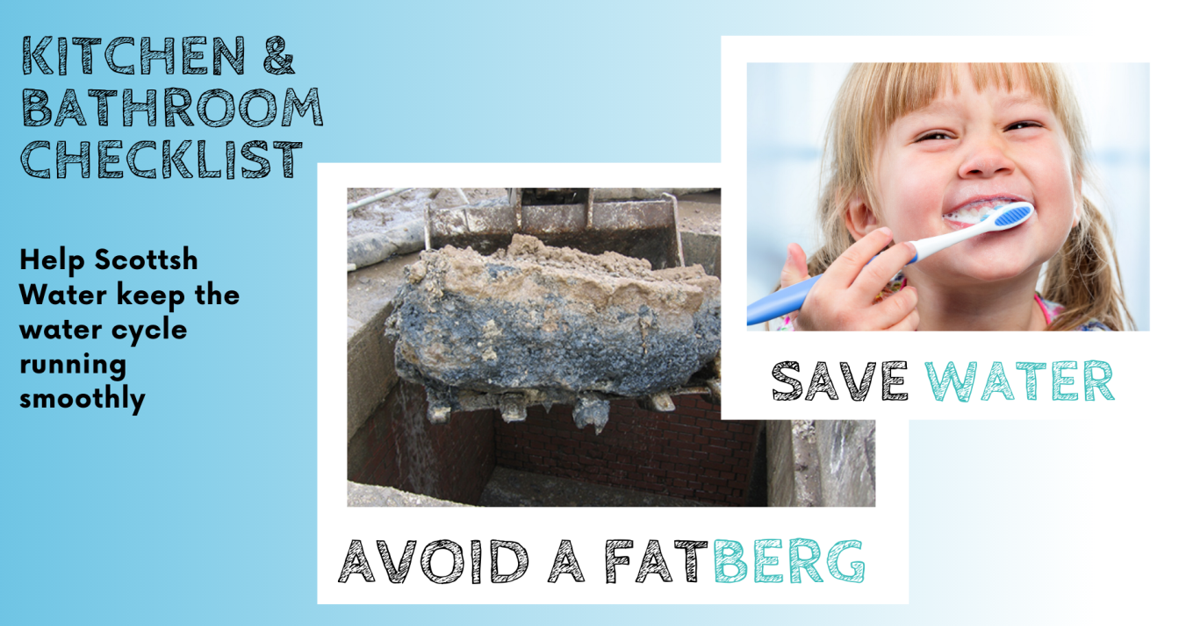
Notes:
Kitchen & Bathroom Checklists
Here’s how you can help keep the water cycle running to homes & businesses across Scotland.
Question - You’ve heard of an iceberg before but have you ever heard of a fatberg? Ewww! (point to picture)
Scottish Water has been working with customers across Scotland advising what not to put down their sinks and drains. This helps to ensure that sewers are lighter of fat, oil and grease– which is what gathers together underground and creates those horrible fat bergs! Yuck.
If you help us by following the below check list, it will help keep the water cycle flowing & keep the yucky fat bergs at bay!
Free to discuss the Kitchen Checklist
Fat, oil and grease - leave to cool/harden in a container and then scrape into your food waste recycling or put them in the bin
Give plates, pots, utensils and containers a quick scrape or wipe with some kitchen towel before washing and use a sink strainer in the plughole to catch any bits of leftover food going down the sink
Believe it or not soup, stocks, sauces and milk products all contain fat, which can also congeal and harden in your drains - leave these to cool/harden, scrape into a container and then scrape into your food waste recycling or put them in the bin
Peelings - put any waste food and peelings into your food waste recycling or put them in the bin
You can also help us to save water by using water wisely all year round.
Question: It’s really important to wash your hands and brush your teeth!
Who brushes their teeth in the morning? (Hopefully the whole room will have their hands in the air) Then ask who leaves the tap running while they brush their teeth or washing hands ?
Answer: Did you know that simply turning off the tap while brushing your teeth helps us save water and energy? Leaving the tap running can waste up to 15 litres of water.

Slide 16
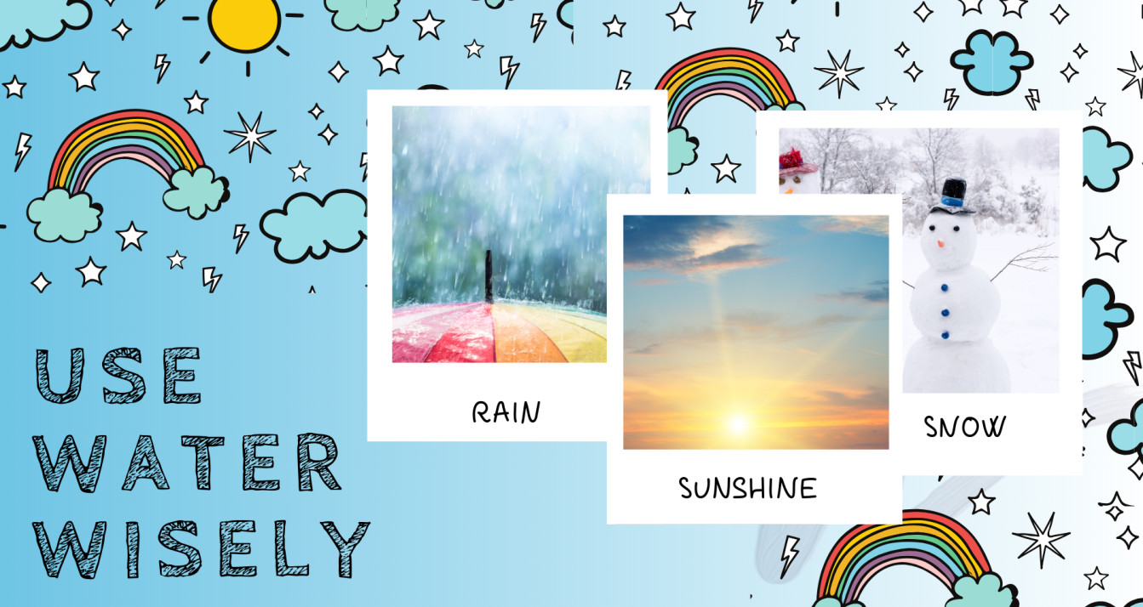
Notes:
Use Water Wisely
You can help by using water wisely all year round! Although we think we get a lot of rain in Scotland, we now know that it is precious. So we have to look after it in the rain, in the sun and in the snow!
Fun fact: Did you know that we can only access a very tiny amount of the rain fall in Scotland? That’s because like we talked about before much of the water goes back into the ground, tree’s, rivers and lakes – it doesn’t all go back into our reservoirs. It means that even though we get a lot of rain, we still need to look after our water.
We know that we can help save water by turning off the tap when brushing out teeth, but what else can we do?
Other water saving tips to remember, free to discuss the below water wisely tips!
Having a 10 minute shower uses up to 80 litres of water. This is the same as a bath. You should try if possible to keep your showers to under 5 minutes.
If you see someone loading the washing machine, ask them to make sure it is full before use.
If you see someone watering the garden with a hose, ask them to use a watering can instead.
Instead of washing dishes under a running tap or using the dishwasher, you should use a basin
When boiling the kettle, you should only boil the water you need.
When washing the car, you should use a bucket and sponge rather than a hose
All of these use water wisely tips will help us work together & ensure future water supplies are resilient!

Slide 17
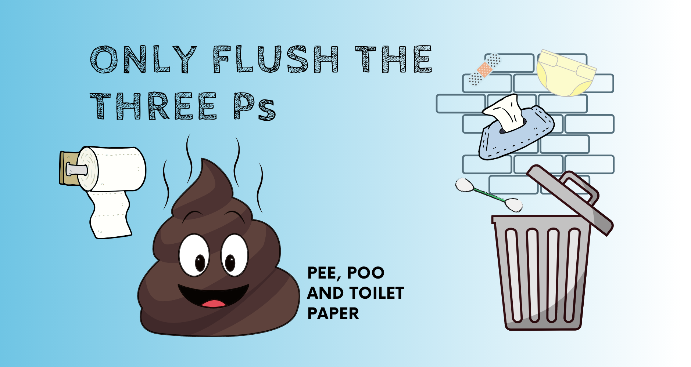

Notes:
Only Flush the 3 Ps
Click to hear sound – A toilet flushing
You can help Scottish Water & our environment by only flushing the three Ps! There should only really be 3 things going down the toilet all beginning with P…
Question: Can anyone guess what those are?
Answer: Pee, Poo & Toilet Paper! (well done if guessed correctly!)
Nothing else should go down the toilet! Anything other than the 3 Ps are non flushable items.
Question: Can you think what else not to flush?
Answers: All wipes (baby, personal cleansing, toilet and household cleaning) - even if the pack says ‘flushable’ items, cotton wool, cotton buds, disposable nappies and nappy liners, used bandages and contact lenses (anything that’s not 3ps)
Option to play game: Shake Test
What you will need:
One baby wipe/face wipe
Toilet Paper
Two bottles with lids you can shake
Water
Ask for 2 volunteers (this can be anyone!) Both volunteers hold up a filled water bottle, one contains a strip of toilet paper, the other bottle contains a wet wipe. Ask the volunteers to shake the bottles as hard as they can. Then ask the rest of the class, what the difference between the toilet paper and wet wipe is?
Answer: The tissue paper has disintegrated, while the wet wipe hasn’t broken down. This is what happens when you flush them down the toilet.
When we flush the wrong items down the toilet they can cause blockages and flooding and also end up in our environment impacting on wildlife – we don’t want that!
So can you help us going forward & promise only to put the 3Ps down the toilet? Pee, Poo & Toilet Paper!

Slide 18
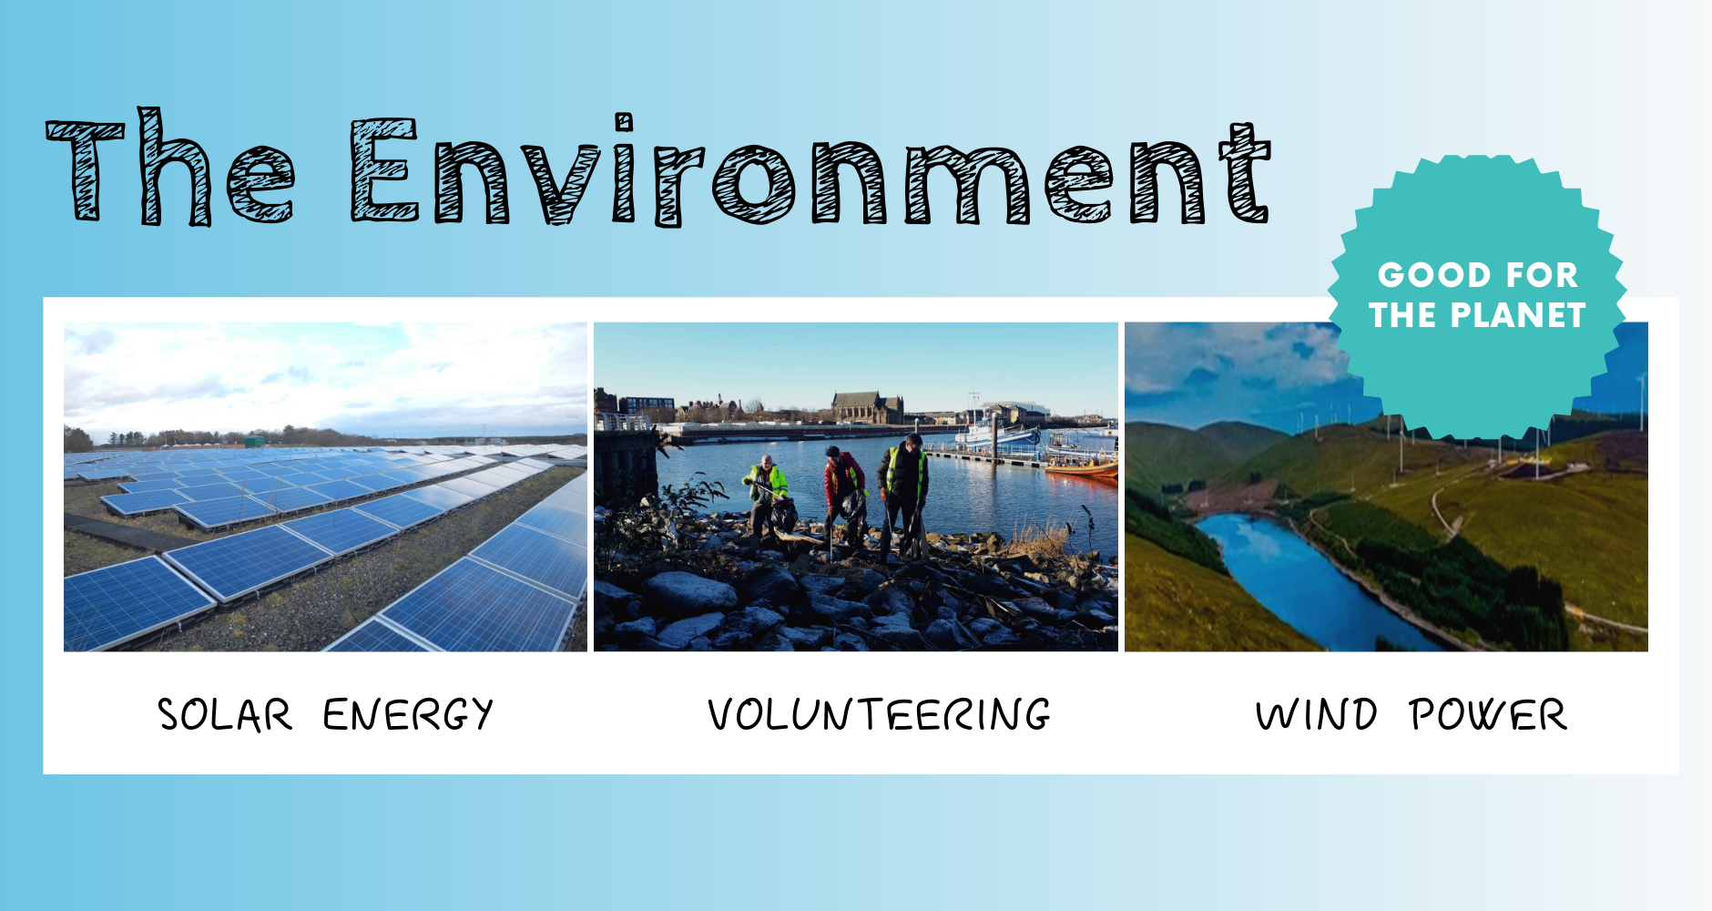
Notes:
The Environment
80% of marine litter starts life on land, this includes what we wrongly flush down the toilet (if it’s not one of the 3Ps) can end up in our rivers, and in turn our oceans. At Scottish Water we try to play our part in protecting our environment, we power many of our treatment works by solar and wind power energy. We have banned single use products from many of our offices such as coffee cups and cutlery.
And every single employee at Scottish Water has two volunteer days a year were we can give back to the community. Show pic of volunteering: Here are our staff picking litter on the River Clyde. 80% of this litter will have started on land before it has then ended up on our shores which impacts on our wildlife and other important ecosystems.
Question: How do you help protect our environment? (in school or at home)
Question: Does anyone know what a carbon footprint is? You might have heard these words before.
Answer: it’s the emissions we create by different individual activities like the food we eat, how we travel (planes, cars etc) and live our lives. Emissions are bad for the planet. Some of what you are doing at home and in school may be helping to reduce your carbon footprint.

Slide 19

Notes:
What are your skills
Scottish Water is working to become a green organization, we want to protect Scotland’s water and our environment. We need lots of people (over 3,000) to help us with our mission. We need lots of different skills to help get the water to homes and businesses, to be environmentally friendly and to communicate with our customers. Skills such as engineering, scientists, communicators and even water tasters!
Fun fact: Have you ever heard of a water taster before? It’s a real job & a very important one. There are 15,000 samples of drinking water from across Scotland checked by a team of 23 water tasters. Their noses and tongues detect anything from too much chlorine, which is added to disinfect all tap water, to earthy, fruity, milky or yeasty taints. The tasters are not there to test the safety of the water but to make sure it smells, tastes and looks right.
Question: Can you think of what skills you have that might be useful to Scottish Water?
Answer: Communicating, drawing/design, team work, building, creative, maths, science, thinking outside of the box etc..

Slide 20
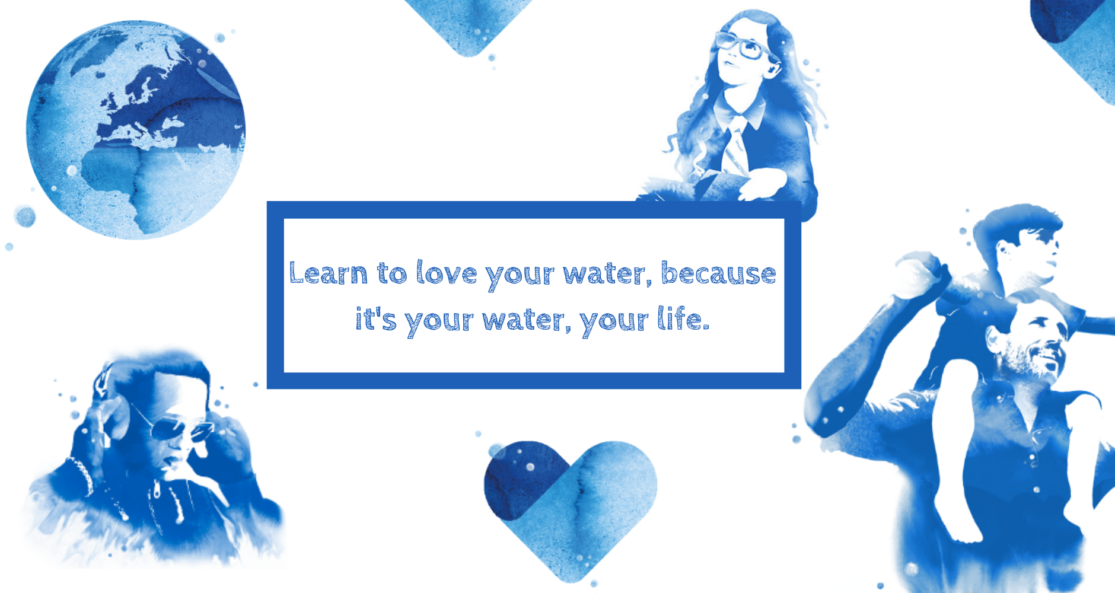
Notes:
Your Water Your Life
Question: Has anyone watched Blue Planet?
Scottish Water was inspired by Sir David Attenborough and the Blue Planet series, it gave them the idea for a campaign called Your Water Your Life which asks you to do one simple thing: Top Up from the Tap using a refillable bottle!
Tap water is good for your health, it’s also a good way to save money because you don’t need to buy bottles of water or juice and finally it’s good for the planet. It means using less plastic and reducing our carbon footprint!
So drink lots of water to keep hydrated & use a refillable water bottle!

Slide 21

Notes:
We must all learn to love our water & work together to make future water supplies more resilient, because it’s your water, your life.
Thank you & well done!
Remember to test your knowledge & take the water cycle quiz.
We would also love to hear from you. Why not draw us a picture of the Water Cycle or create a Video (perhaps using Tik Tok) to show us how you are saving water or perhaps how you use water? Tweet @ScottishWater or send to lauren.allan@scottishwater.co.uk. With a parent or guardian’s permission we will share across our social media channels, Facebook, Twitter & Instagram!

