Slide 1

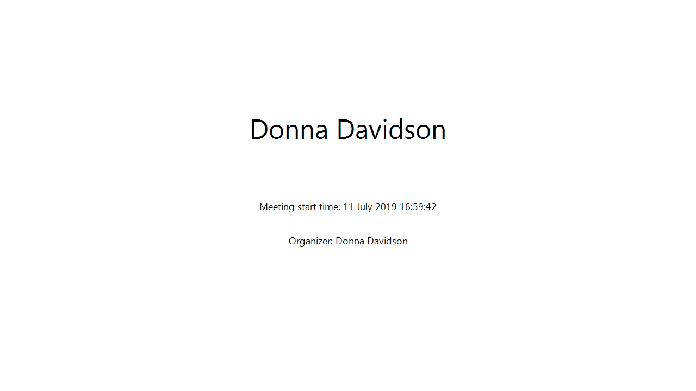

A General Overview of the Customer Portal
Please note: this video was prepared in 2019
Please keep in mind that the presented screens are subject to change

